Slide 1
Data Visualizations

Slide 2
Why do we need visualizations

Slide 3
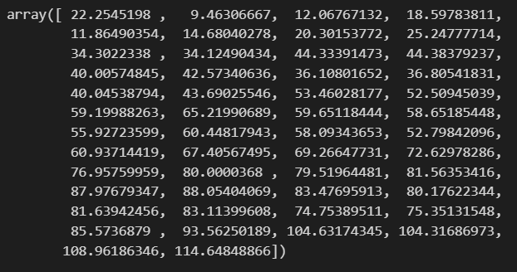
Before

Slide 4
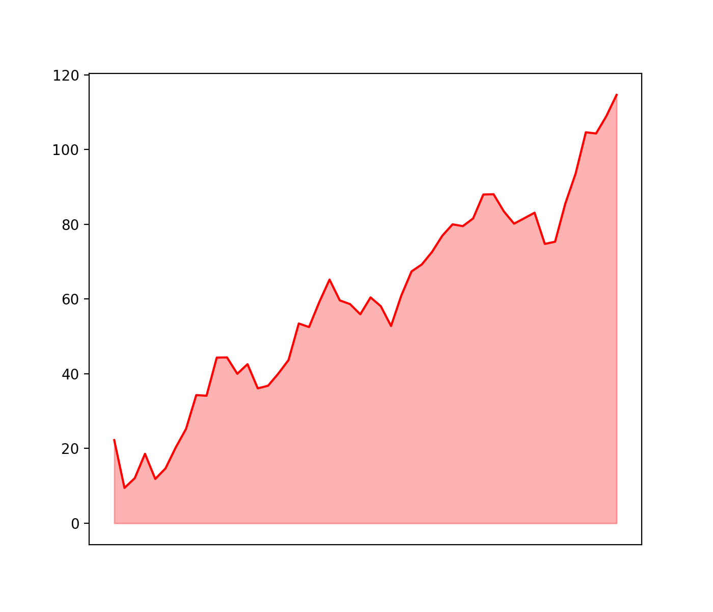
After

Slide 5
Main libraries

Slide 6
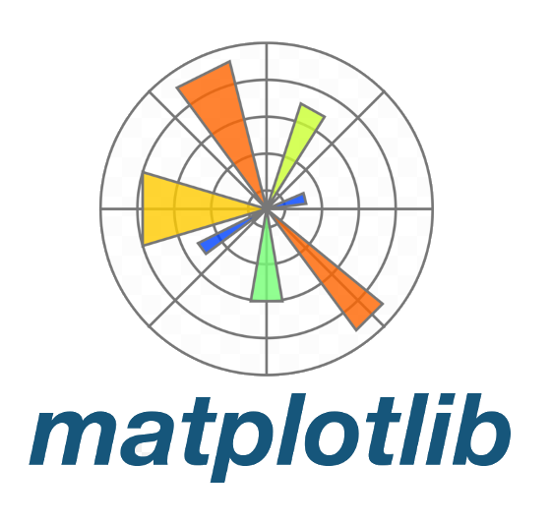
Main libraries
Fundamental

Slide 7

Main libraries
Fundamental

Slide 8

Main libraries
Fundamental
Interactive

Slide 9
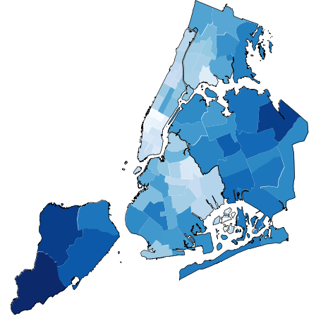
Main libraries
Fundamental
Interactive
Geospatial
Geoplot

Slide 10

Main libraries
Fundamental
Interactive
Geospatial
Geoplot

Slide 11
Other visualization apps

Slide 12



Other visualization apps

Slide 13
How to visualize data distribution

Slide 14
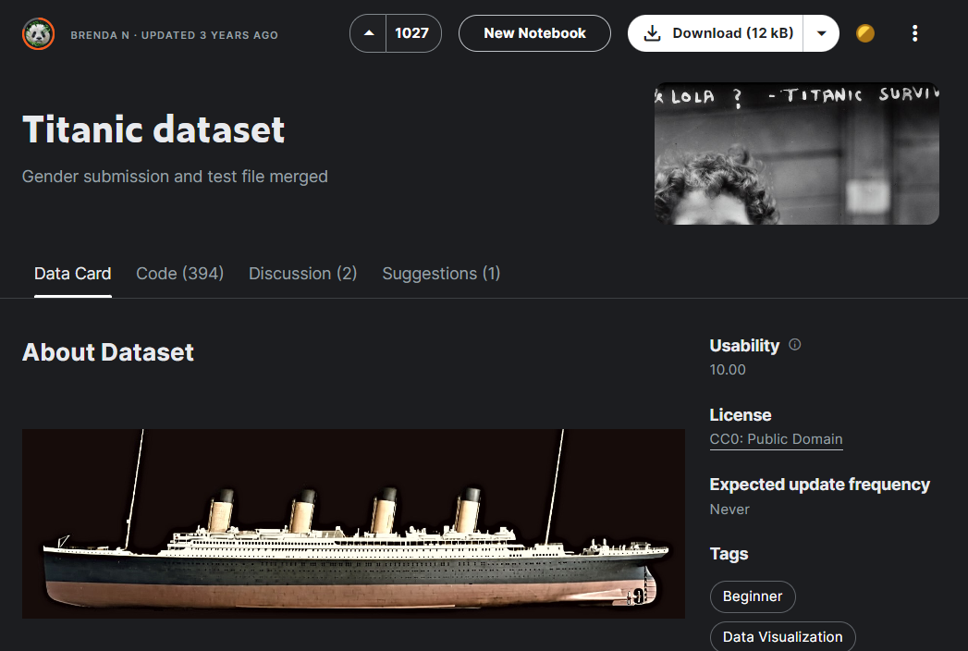

Slide 15
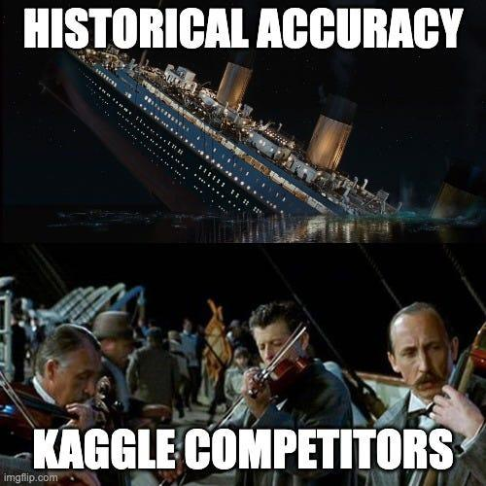

Slide 16
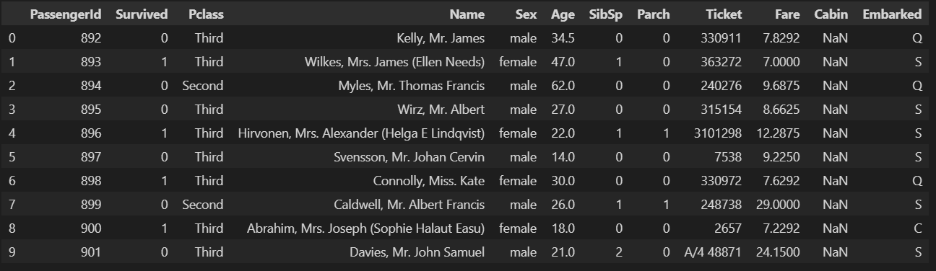

Slide 17
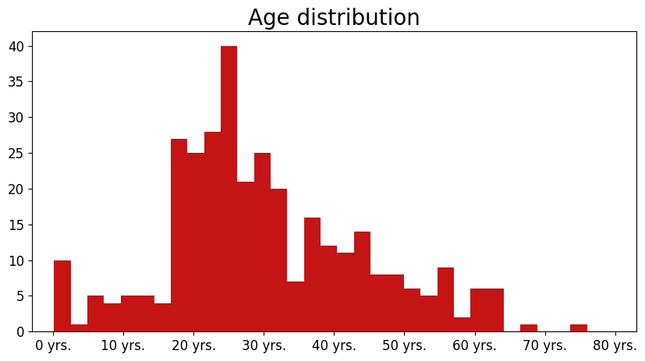
Histogram

Slide 18
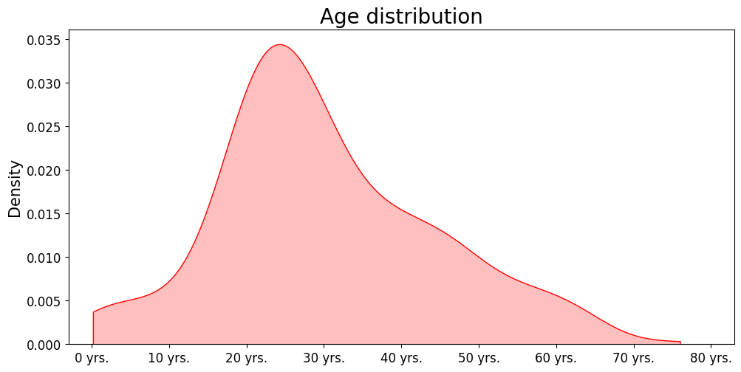
Density plot

Slide 19
Comparing multiple distributions

Slide 20
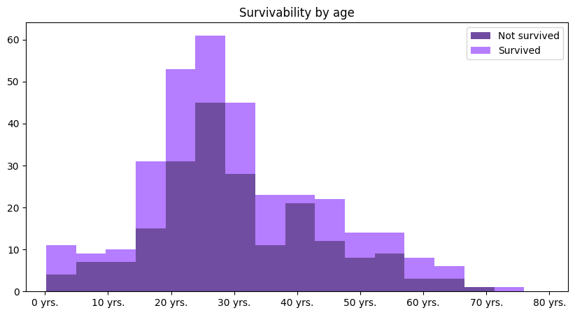
Stacked histogram

Slide 21
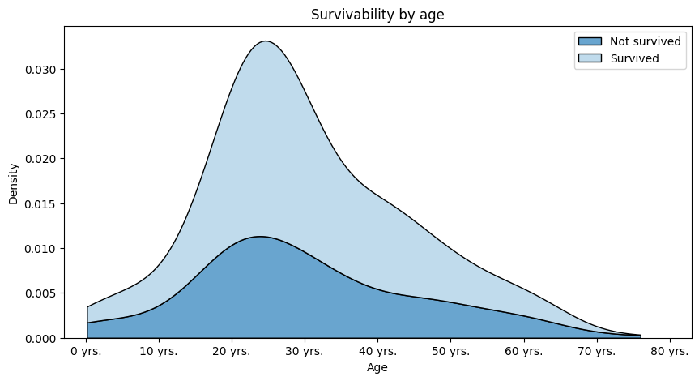
Stacked density plot

Slide 22
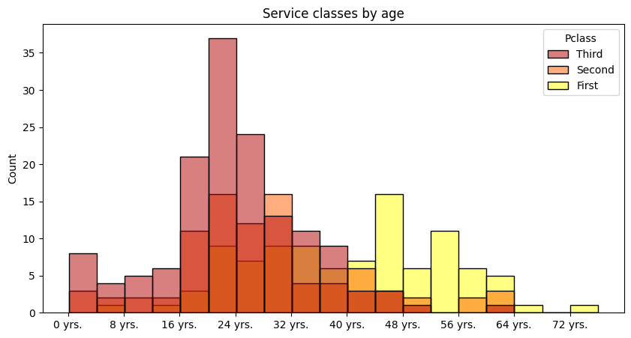
Stacked density plot

Slide 23
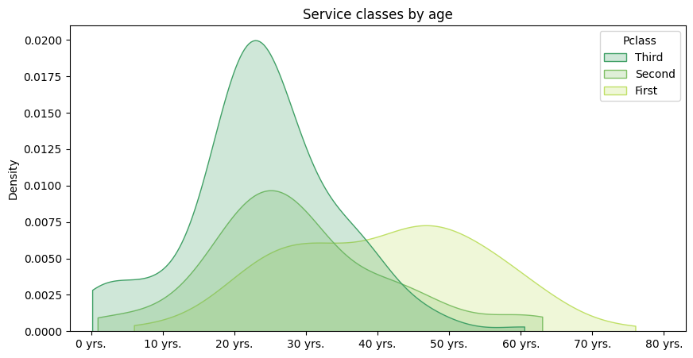
Stacked density plot

Slide 24
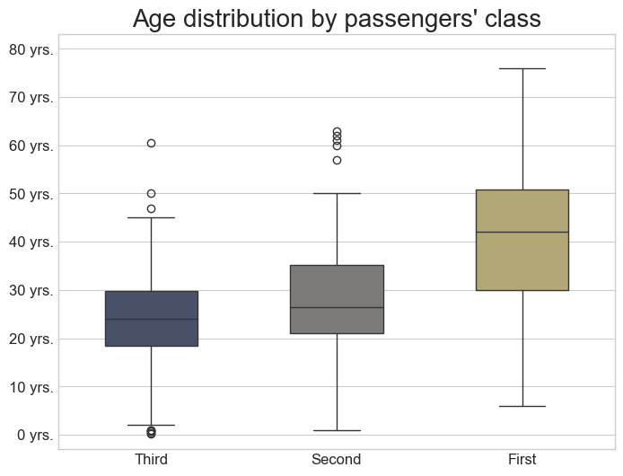
Box plots

Slide 25
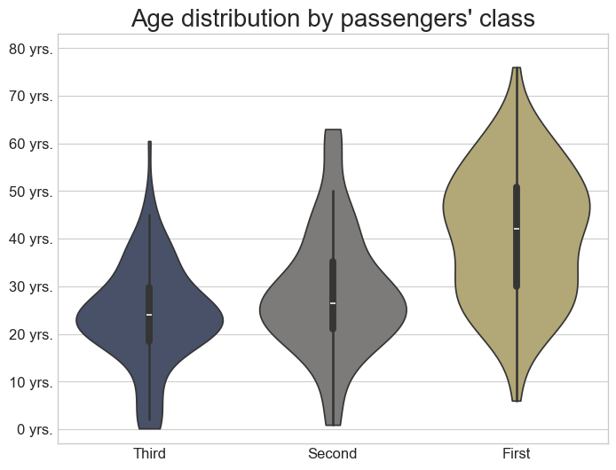
Violin plot

Slide 26
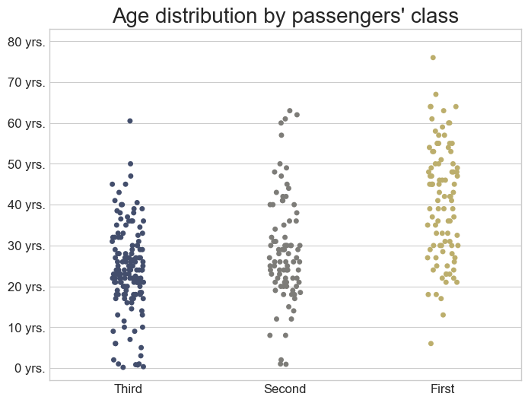
Strip plot

Slide 27
Logarithmic scale

Slide 28
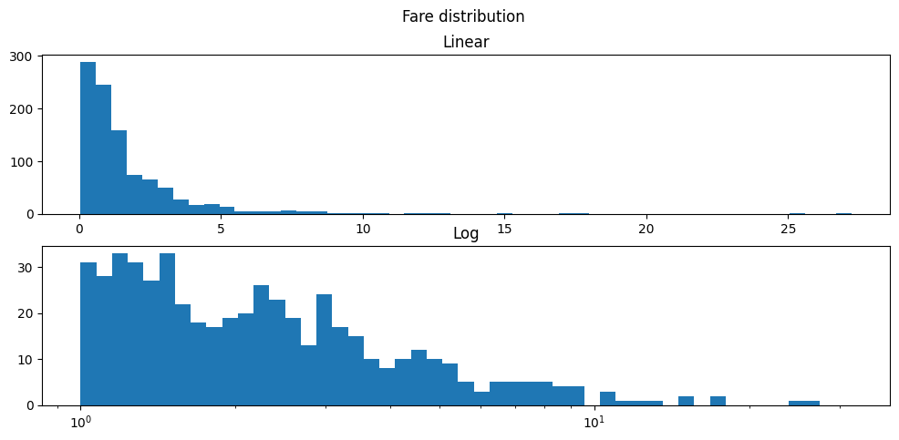
Logarithmic scale

Slide 29
Real vs theoretical distribution

Slide 30
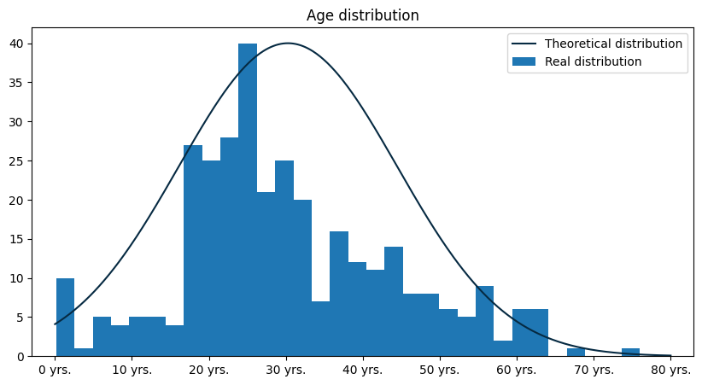
Real vs theoretical distribution

Slide 31
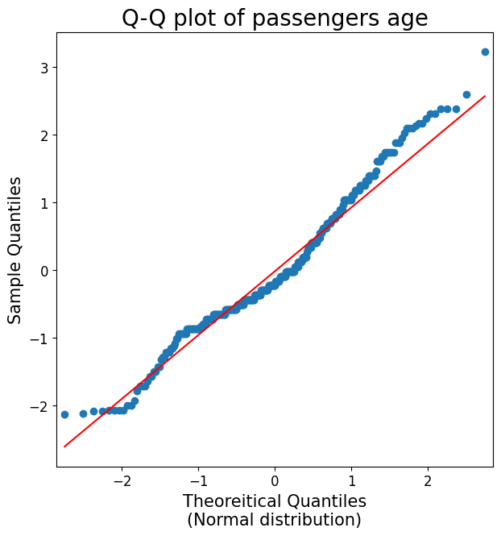
Real vs theoretical distribution

Slide 32
Frequently made mistakes

Slide 33
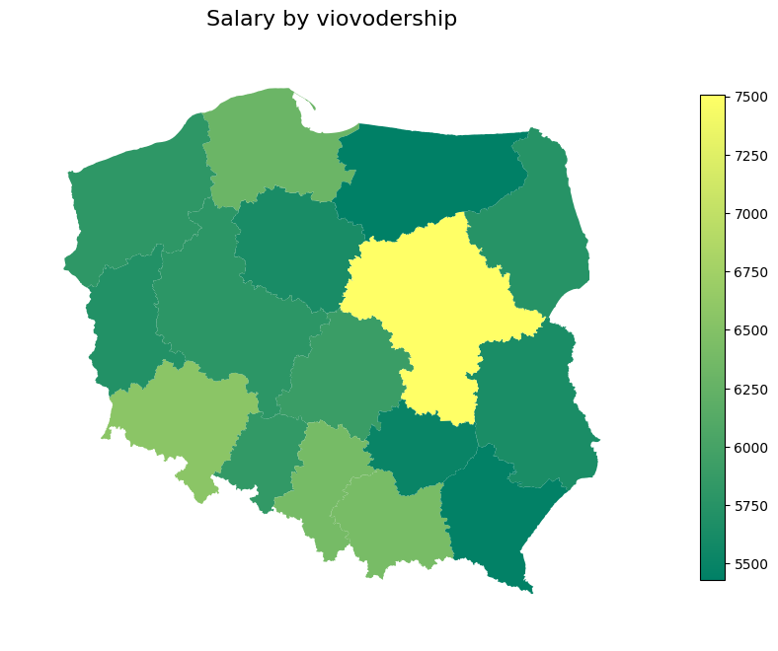
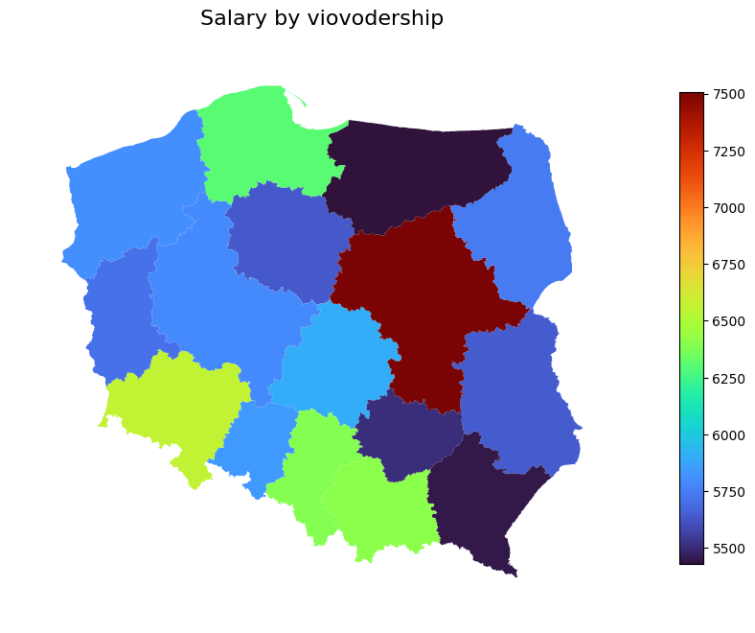
Incorrect color scale

Slide 34
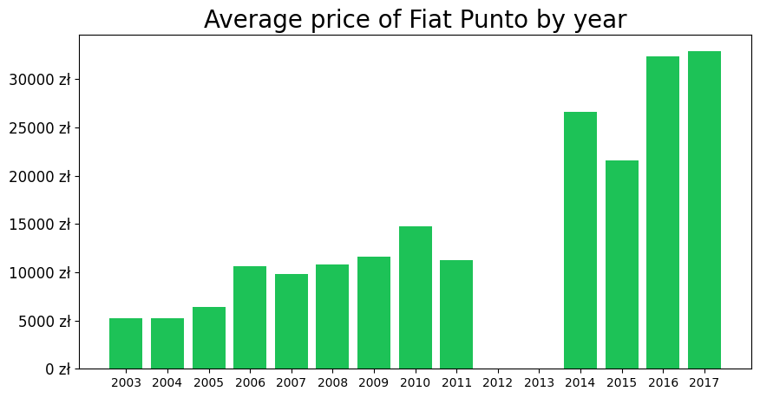
Informing about missing data

Slide 35
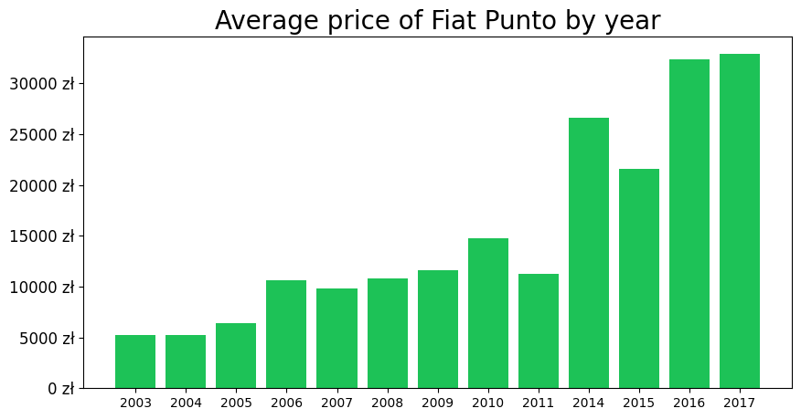
Informing about missing data

Slide 36
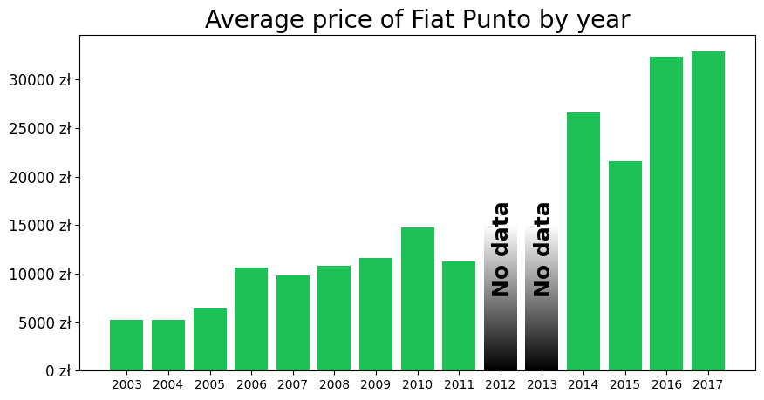
Informing about missing data

Slide 37
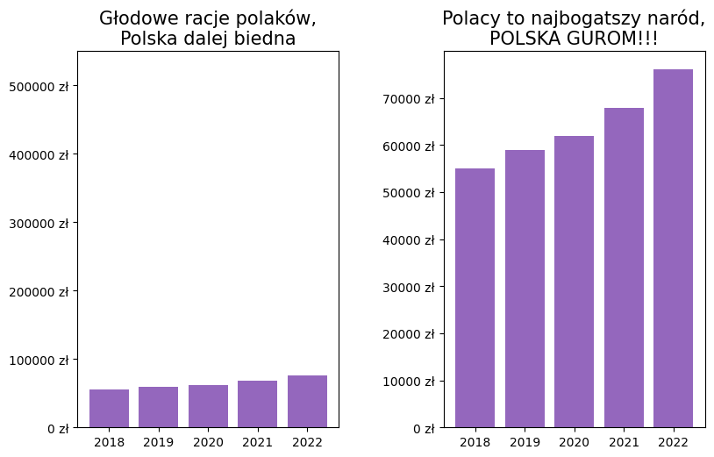
Manipulating scale

Slide 38
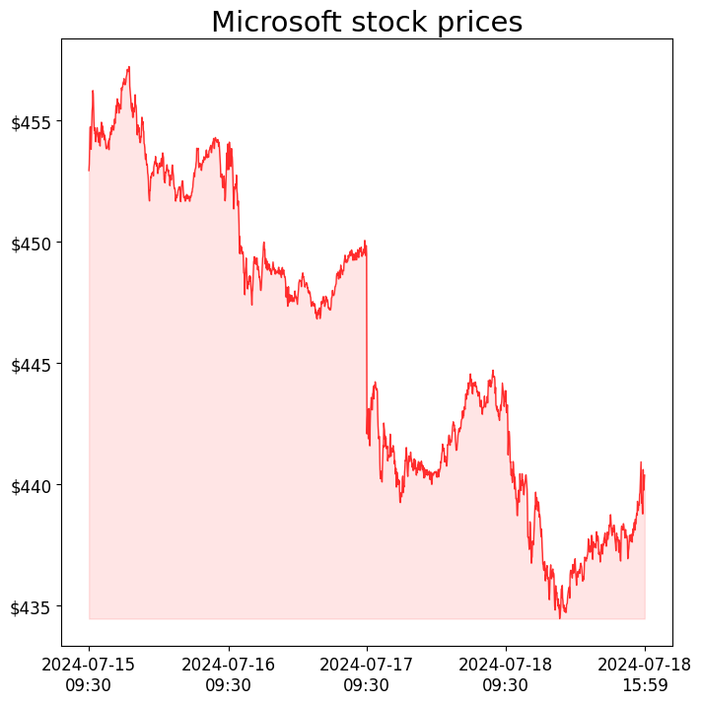
Manipulating scale

Slide 39
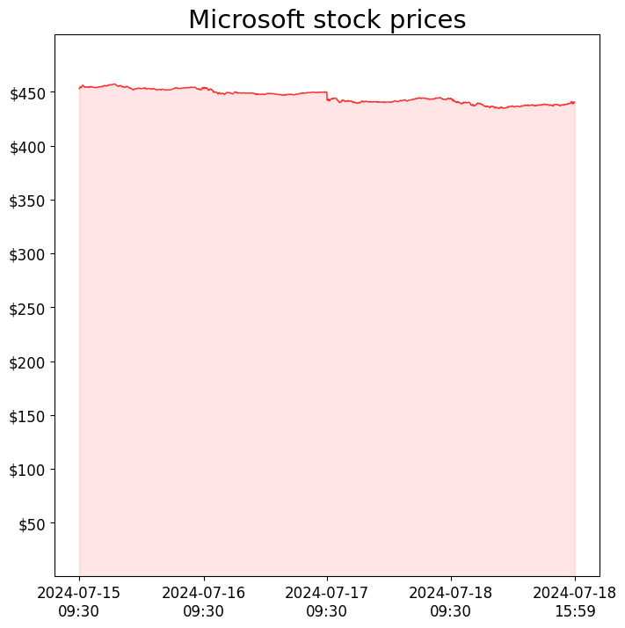
Manipulating scale

Slide 40
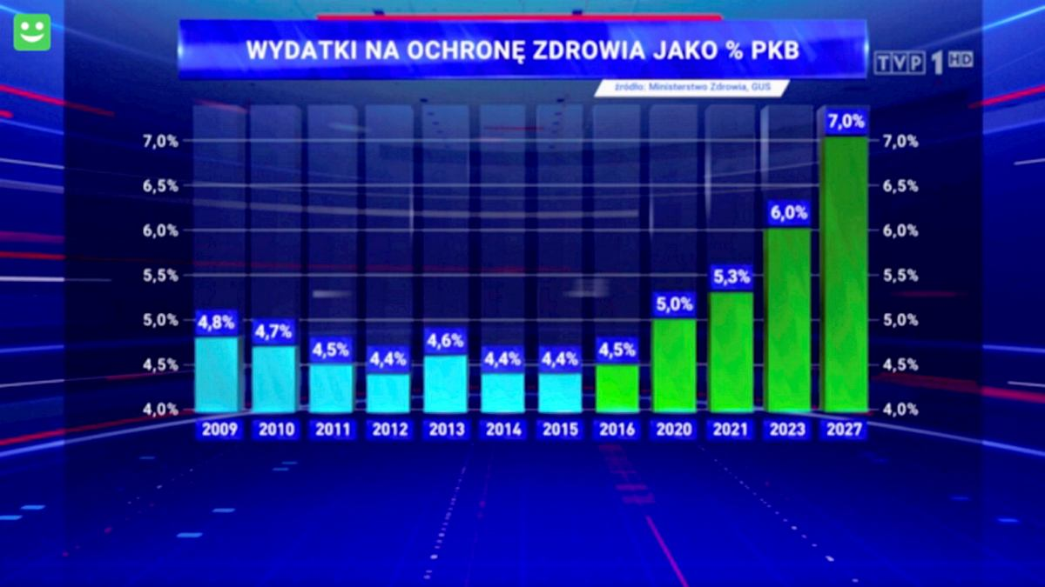
Manipulating scale

Slide 41
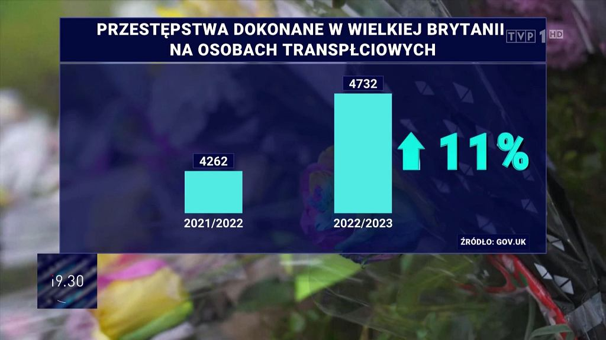
Manipulating scale

Slide 42
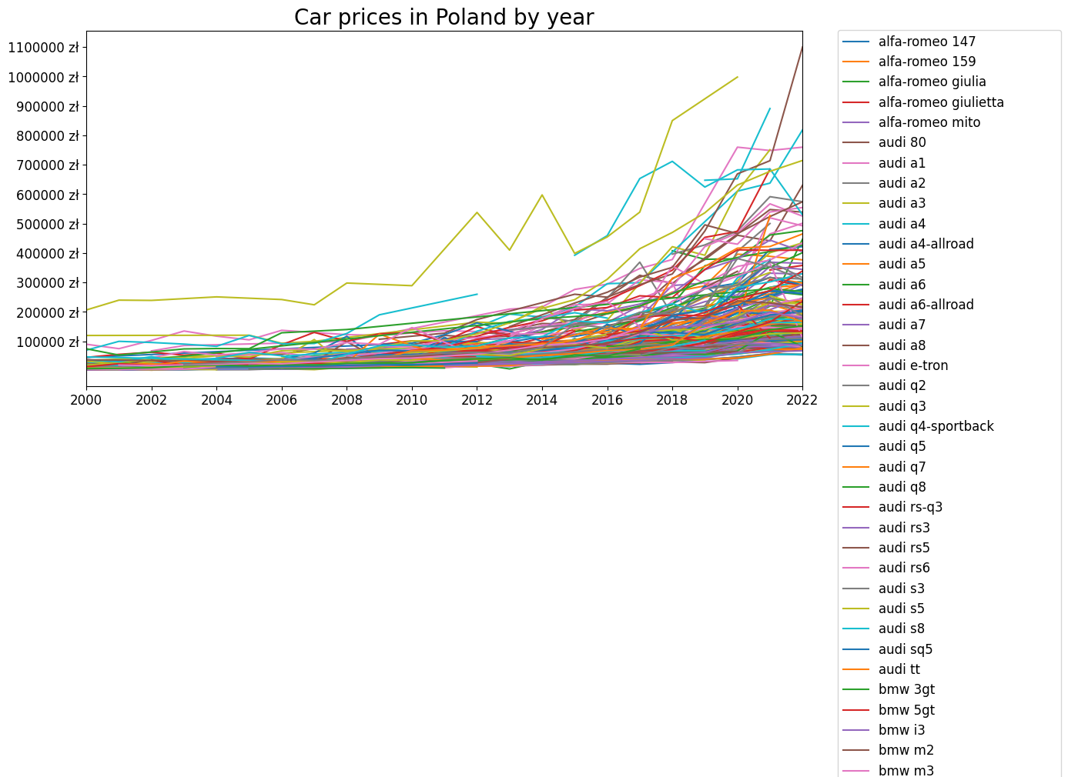
Too many informations

Slide 43
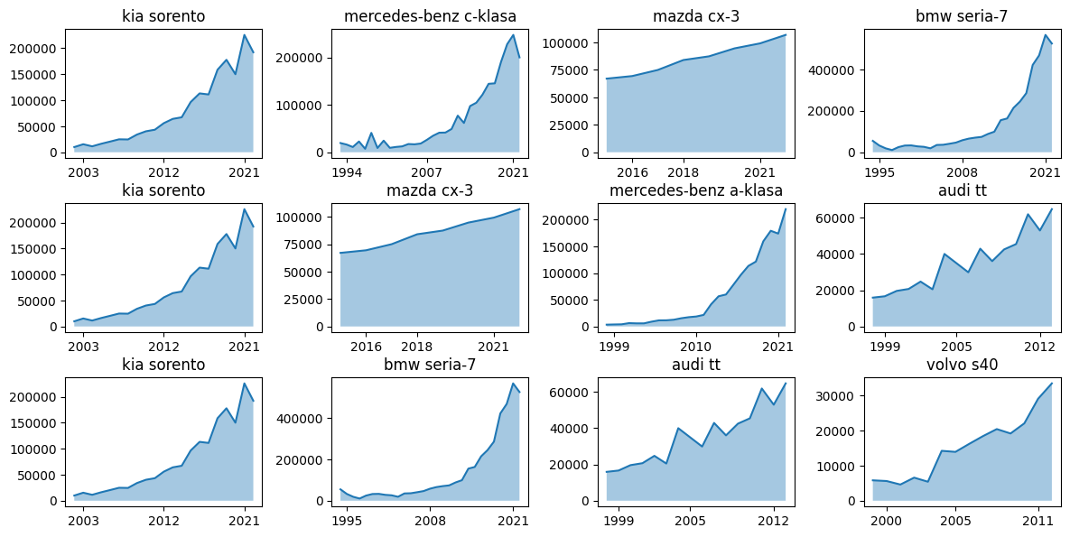
Too many informations

Slide 44
References
https://github.com/Skamlo/Visualization-Techniques-in-Python
https://towardsdatascience.com/kernel-density-estimation-explained-step-by-step-7cc5b5bc4517

